Slide 1
COMP 3400
Week 3 - Friday

Slide 2
Last time
What did we talk about last time?
Files
  Opening
  Closing
  Reading
  Writing
  Polling

Slide 3
Questions?

Slide 4
Assignment 2

Slide 5
Project 1

Slide 6
Files

Slide 7
File metadata
The data in the file is the sequence of bytes it contains
The metadata of a file gives information about the file itself
  Obscure OS stuff like inode number and hard links to the file
  User ID of the owner
  Group ID of the owner
  Device type
  File size
This information can be stored in a struct stat and retrieved with:
  fstat() Gets information from a file descriptor
  stat() Gets information from a path

Slide 8
Interpreting metadata
The following shows some fields in struct stat
The st_mode field is a bitwise OR of permissions and other information from the table on the right
struct stat {
dev_t st_dev; // device of inode
ino_t st_ino; // inode number
mode_t st_mode; // protection mode
nlink_t st_nlink; // hard links to file
uid_t st_uid; // user ID of owner
gid_t st_gid; // group ID of owner
dev_t st_rdev; // device type
off_t st_size; // file size in bytes
// Other fields depending on OS ...
};
Name | Description
S_IFIFO | Named pipe (IPC)
S_IFCHR | Character device (terminal)
S_IFDIR | Directory file type
S_IFBLK | Block device (disk drive)
S_IFREG | Regular file type
S_IFLNK | Symbolic link
S_IFSOCK | Socket (IPC, networks)

Slide 9
Example getting file metadata
The following code finds out how big a file (stored with file descriptor fd) is in bytes:
struct stat metadata;
fstat (fd, &metadata);
printf ("File size: %lld bytes\n",
(long long)metadata.st_size);

Slide 10
Events and Signals

Slide 11
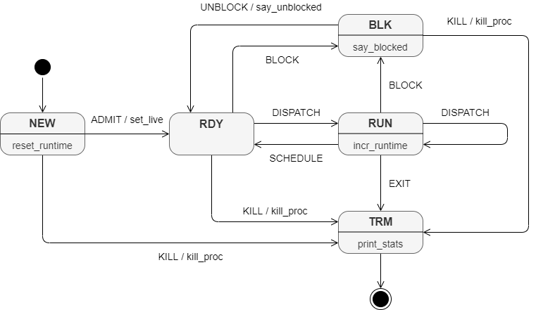
Events
Processes are created, run, and are eventually destroyed
As shown in Assignment 2, processes can also:
  Go into a blocked state, waiting for I/O
  Be suspended, which means it doesn't get scheduled
We can cause an event to happen to a process by sending it a signal

Slide 12
Command line signals
You can send signals to processes from the command line
  Ctrl-C: SIGINT (interrupt)
  Ctrl-Z: SIGTSTP (terminal stop, usually suspends)
Signals often result in the process being killed
Perhaps for that reason, the kill command is used to send arbitrary signals (not just killing ones)
  Flag gives the kind of signal
  Then specify the PID of the process
> kill –KILL 8382

Slide 13
Common signals
When using the kill command, the flag can either be the name of the signal (-KILL) or its number (-9)
Here are some common signals:
Name | Number | Description
SIGINT | 2 | Interrupts the process, generally killing it. Sent with Ctrl-C.
SIGKILL | 9 | Kills the process. Cannot be ignored or overwritten.
SIGSEGV | 11 | Sent to a process when it has a segmentation fault.
SIGCHLD | 18 | Sent to a parent when a child process finishes. Used by wait().
SIGSTOP | 23 | Suspends the process. Cannot be ignored or overwritten.
SIGTSTP | 24 | Suspends the process. Sent with Ctrl-Z.
SIGCONT | 25 | Resumes a suspended process.

Slide 14
Details on signals
Some signals are similar
  SIGINT and SIGKILL both kill the process
  SIGSTOP and SIGTSTP both suspend the process
Some of these signals can be overridden to do different things (and some can't)
Have you ever meant to put the & down when you run gedit or another GUI program?
  You can suspend the program by typing Ctrl-Z, then run bg to move it to the background
Normally, SIGSEGV causes a program to print an error message and die
  It's possible to make a custom signal handler to do something different
  Debuggers like gdb do this

Slide 15
Sending signals in a program
Just as you can use the kill command from the command line, you can also call the kill() function to send a signal to another process
The function takes two parameters:
  PID of the process to kill
  int value giving the signal, usually a named constant
You can usually only kill processes that you own
  Unless you're a superuser (like root)
kill (pid, SIGSTOP); // Suspends process with pid

Slide 16
Example of kill() function
Below, a parent forks a child
The child goes into an infinite loop
Then, the parent kills the child
pid_t child_pid = fork ();
if (child_pid < 0)
exit (1); // exit if fork failed
if (child_pid == 0)
while (1) ; // child loops
sleep (1); // parent sleeps for 1 second
kill (child_pid, SIGKILL); // parent kills the child

Slide 17
Custom signal handlers
Although signals have default actions for processes, some signals can be overridden
A process can define what happens when, for example, it's interrupted
First, you need a function that will get called when a particular signal happens
  It must take an int (the signal) and return void
Example that prints "I don't want to die!" and then exits
static void
handler(int signal)
{
write(STDOUT_FILENO, "I don't want to die!\n", 21);
exit(0);
}

Slide 18
Asynchronous signal safe
Wouldn't it have been easier to call printf() in the previous signal handler example?
Yes, but you should not
Only asynchronous signal safe functions should be called in signal handlers
  Or else the results are unpredictable!
Functions that have static buffers inside of them (like printf() and scanf()) are not asynchronous signal safe
For more information (and a list of functions In you can call):
TLDR: Keep signal handlers short, don't call functions unless you're sure they're safe, and printf() and scanf() are not safe
> man signal-safety

Slide 19
Overriding the signal handler
Once you've written the custom signal handler, you have to override it with the sigaction() function:
The action parameter is a struct sigaction with a function pointer to the new handler
The old parameter is NULL unless you want to find out what the old signal handler was
int sigaction(int signal, const struct sigaction *action, struct sigaction *old);

Slide 20
Overriding example
The following code overrides the SIGINT signal with the handler from a couple of slides back
Then it goes into an infinite loop until someone interrupts it (like with Ctrl-C)
int
main (int argc, char *argv[])
{
struct sigaction sa; // Struct we'll add the handler to
memset(&sa, 0, sizeof(sa)); // Zero out the contents first
sa.sa_handler = handler;
// Override SIGINT handler
if (sigaction (SIGINT, &sa, NULL) == -1)
printf ("Failed to overwrite SIGINT.\n");
printf ("Entering loop\n");
while (1); // Loop until signal
return 0;
}

Slide 21
Reborn like a phoenix
It's sort of cool that we can make a handler print something special before crashing the program
But we can also do some code to handle the signal and then jump back to a safe location
  Away from blocked I/O or an infinite loop
  Somewhere that's been marked and is still on the stack
To do that, we need two functions
// Set jump location
int sigsetjmp(sigjmp_buf context, int mask);
// Jump to location
int siglongjmp(sigjmp_buf context, int value);

Slide 22
Full example
sigjmp_buf context;
static void handler(int signal)
{
write(STDOUT_FILENO, "I don't want to die!\n", 21);
siglongjmp (context, 1); // Jumps to marked location with value 1 (insane!)
}
int main (int argc, char *argv[])
{
struct sigaction sa;
memset(&sa, 0, sizeof(sa)); sa.sa_handler = handler;
if (sigaction (SIGINT, &sa, NULL) == -1)
printf ("Failed to overwrite SIGINT.\n");
if (sigsetjmp (context, 0)) // Marks location and returns 0 the first time
printf ("Resuming execution\n");
printf ("Entering loop\n");
while (1); // Loop until signal
return 0;
}

Slide 23
Except, of course, there's more
Signal handling can be tricky
What happens when a signal is sent a second time?
There are masks you can set in the struct sigaction that determine if your handler is used repeatedly
The sigprocmask() function can also be used to change which signals are blocked, inside of your handler

Slide 24
Upcoming

Slide 25
Next time…
Interprocess communication (IPC)

Slide 26
Reminders
Finish Assignment 2
  Due tonight by midnight!
Keep working on Project 1
Read sections 3.1 and 3.2

